Slide 1
Basics of Control Engineering CODE: EE 8111

Slide 2
Course expected learning outcomes
Identify different types of control systems.
Apply control elements in control systems.
Describe the functions of control elements.
Describe the functions of controllers

Slide 3
contents
Types of Control Systems;
Basic concepts of automation and control systems, classification of control systems; manual, semi and fully automated control systems
Elements of Automatic Control System:
Basic characteristics of control system and its connection
Transducers:
Types of transducers; use of transducers with measuring instruments to measure different quantities; strain gauge theory; use of a strain gauge transducer as an error detector; derivation of the equation relating resistance and linear angular displacement in a potentiometer; transducer characteristics.
Sensors:
Types of sensors; application of different types of sensors
Actuators:Definition of actuator, classification of actuators, applications of actuators.
Synchros:
Define the synchro, constructions and mode of option of synchro transmitter and receiver, the control transformer, the sine-cosine rotary transformer, synchro data transmission circuit, the use of synchros in error detectors and position control systems, formation of an AC error signal a transmitter and a synchro control transformer.
Controllers:
Define and mention types of controllers

Slide 4
Learning Context
Control Engineering System
Basic concept of automation and control system
Classification of control system;
Manual
Semi automated control system
Full automated control system
Elements of automatic control system
Basic characteristics of control system and its connections

Slide 5
Cont..
Meaning, types , characteristics, application of:
Transducers
Sensors
Actuators
Synchros
Controllers

Slide 6
Introduction
Every activity in our daily life is influenced by some sort of control system.
Control system is now an integral parts of modern industrialization, industrial process and home appliances.
Control systems and its components play a vital role in our daily life
A control system consists of interconnected components designed to achieve a certain desired output.
Modern control engineering practice includes the use of control design strategies for improving manufacturing processes, the efficiency of energy use, advanced automobile control, etc

Slide 7
Cont..
Terminologies
Control system: is an interconnection of components forming a system configuration that will provide a desired system response. OR
A control system is an arrangement of physical components connected or related in such a manner as to command, regulate, direct or govern itself or another system.
System: is an interconnection of elements and devices for a desired purpose or, Is a combination of components that act together and perform a certain objective
Process: the device, plant, or a system under control. The input and output relationship represents the cause and effect relationship of the process
Disturbance: is a signal that tends to adversely/harmfully affect the value of the output of a system. If a disturbance is generated within the system, it called internal while an external disturbance is generated outside the system and will be the part of the input.

Slide 8
Cont..
Feedback control: refers to an operation that in the presence of disturbances, tends to reduce the difference between the output of the system and some reference input and does so on the basis of the difference
Feedback control system: is a system that maintains a prescribed relationship between the output and the reference input by comparing them and using the difference as a measure to control
A good example of a feedback control system is a room temperature control system.
e.g, by measuring the actual room temp. and comparing it with the reference temp. (desired one), the thermometer turns the heating or cooling equipment ON or OFF in such a way to ensure that the room temp. remains at a comfortable level regardless of outside conditions.

Slide 9
Different types of systems
All our tools and machines need appropriate control to work, otherwise it will be difficult to finish their designated tasks accurately. Therefore, we need control systems to guide, instruct and regulate our tools and machines. Common control systems include:
Mechanical system
Electronic system
Computer control system
Pneumatic (hydraulic) system
Electrical system
A system usually contains three main parts: input, process and output.

Slide 10
Cont..
Mechanical system
A mechanical system is a device made up of various mechanical parts. Its input is provided by an effort. Once the effort and is applied, it can set off a motion to move a load. The force applied to the load is the output of the mechanical system. Examples of mechanical systems include levers, gears and shafts.

Slide 11
Cont..
Electronic system
An electronic system is a system that employs electronic signals to control devices, such as radios, calculators, video game machines, mobile phones, portable computers, etc . The input of an electronic system is provided by electronic signals. After they are processed, they can generate output signals, which control the operation of various devices, such as amplifiers
Electronic systems can carry out many different tasks, such as generating sound, transmitting information, displaying video, measuring, memorizing, calculating, etc. Common examples of electronic devices include semi-conducting diode, transistors, capacitors that they are usually welded onto electronic circuit boards

Slide 12
Cont..
Computer control system
A computer control system uses a computer to control its output devices according to different input signals. Its function is similar to that of an electronic system. Yet a computer control system can use high speed calculation to process large volume of input signals within a very short time, and then generates appropriate outputs with the help of preset programs. Examples of computer control systems include computer numerical control press brakes, computer controlled home appliances, computer controlled underground railway systems, etc

Slide 13
Cont..
Pneumatic system
A pneumatic system is a system that uses compressed air to transport and control energy. Air is first pressurized to give energy in the cylinder. Then signals are input into the system through the use of switches. Next, air is transferred through sealed pipes to the pneumatic parts for processing.
Finally, the force produced by the pneumatic parts is utilized to finish the designated task. The use of pneumatic systems is very extensive, for example, in controlling the movement of train doors, the operation of automatic production lines and mechanical clamps, etc
Hydraulic system (uses compressed liquid)

Slide 14
Different types of control systems
Open loop and closed loop control systems
Manual and automatic control systems
Special applications of the control systems

Slide 15
A. Open loop and closed loop control systems
Two main types of control system
Closed-loop (feedback) control system – a system in which the output variable is compared with an input parameter, and any difference between the two is used to drive the output into agreement with the input
Feedback control systems are often referred to a closed-loop control system. They utilize feedback to compare the actual output to the desired response.
In a closed-loop control system, the actuating error signal which is the difference the input signal and the feedback signal (which may be the output signal itself, or the function of the output signal and its derivatives and/or integral), is fed to the controller so as to reduce the error and bring the output of the system to a desired value

Slide 16
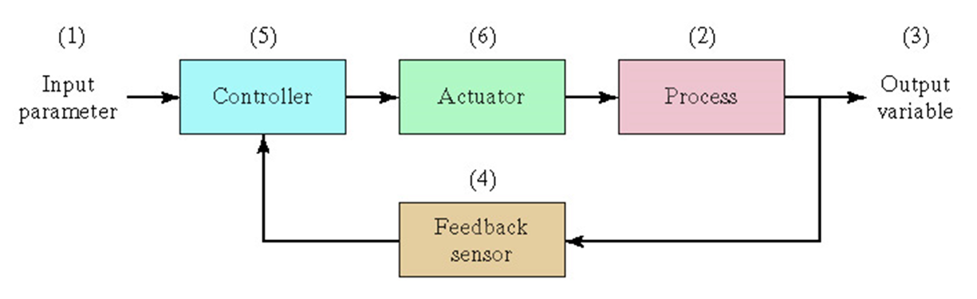
Cont..
Note: the term closed-loop control always implies the use of feedback control action in order to reduce the system error
Examples are: refrigerator, iron, …..

Slide 17
Cont..
Multi Input Multi Output (MIMO) System
Desired Output Response
Controller
Process
Output Variables
Measurement

Slide 18
Cont..
Open-loop control system – operates without the feedback loop. Are the systems in which the output has no effect on the control action. They utilize a controller or control actuator to obtain the desired response. In an open-loop control system the output is neither measured nor feedback for comparison with the input. Thus, to each reference input, there corresponds to a fixed operating conditions, as a result, the accuracy of the system depends on calibration. In the presence of disturbances, the system will not perform the desired task of rectifying
Examples are:
Washing machine, soaking, … the machine doesn’t measure the output signal ie, the cleanness of the clothes.

Slide 19
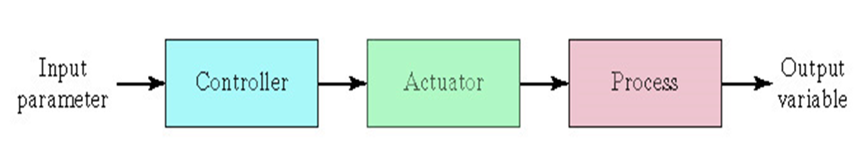
Cont..
Note: any control system that operates on time basis is open-loop. For instance, traffic control by means of signal operates on a time basis is another example of an open-loop control

Slide 20
Cont..
General Control System
Forward Path: The forward path in the feedback loop is the path after the summer, that travels through the plant and towards the system output.
The reverse path is the path after the pick-off node, that loops back to the beginning of the system. This is also known as the "feedback path".
Disturbance
Controlled Signal
Manipulated Variable
Error
Set-point or Reference input
+
+
+
Controller
Actuator
+
+
Process
-
Actual Output
Sensor
Feedback Signal

Slide 21
Cont..
Closed-loop Vs open-loop control systems
An advantage of the closed-loop control system is the fact that the use of feedback makes the system response relatively insensitive to the external disturbances and internal variation is system parameter
Generally, closed-loop control system have advantages only when unpredictable disturbances and/or unpredictable variations in the system components are present
Disadvantage: complicated in design, expensive,

Slide 22
Cont..
The major advantages of an open-loop are:
Simple in construction and easy in maintenance
Less expensive
Actions performed by the control system are simple
Actuating function is very reliable
There is no stability problem
Convenient when the output is hard to measure or measuring the output is precisely not feasible economically, eg in washer system
If these conditions do not apply, then a closed-loop control system should be used
The major disadvantages are:
Disturbances and changes in calibration cause errors, and the output may be different from the desired one
To maintain the required quality in the output, the recalibration is necessary from time to time
Risk that the actuator will not have the intended effect

Slide 23
B. Manual and automatic control systems
Manual
Semi automated control system
Full automated control system
Control is a process of causing a system variable such as temperature to conform to some desired value or trajectory, called reference value or trajectory.
For example, driving a car implies controlling the vehicle to follow the desired path to arrive safely at a planned destination.
If you are driving the car yourself, you are performing manual control of the car.
If you use design a machine, or use a computer to do it, then you have built an automatic control system.

Slide 24
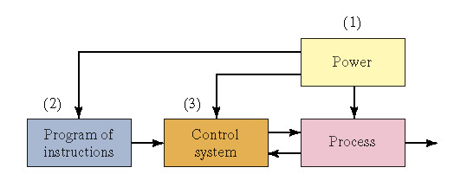
Cont..
Automation: is the technology by which a process or procedure is accomplished without human assistance.
Basic elements of an automated system
Power - to accomplish the process and operate the automated system
Program of instructions – to direct the process

Slide 25
Cont..
Power Source
Widely available at moderate cost
Can be readily converted to alternative forms, e.g., mechanical, thermal, light, etc.
Low level power can be used for signal transmission, data processing, and communication
Power for the process
To drive the process itself
To load and unload the work unit
Transport between operations
Power for automation
Controller unit
Power to actuate the control signals
Data acquisition and information processing

Slide 26
Cont..
Program of Instructions
Set of commands that specify the sequence of steps in the work cycle and the details of each step
During each step, there are one or more activities involving changes in one or more process parameters
Examples:
Temperature setting of a furnace
Motor on or off

Slide 27
C. Special applications of the control systems
There are many household and industrial application examples of the control systems, such as washing machine, air conditioner, security alarm system and automatic ticket selling machine, etc.

Slide 28
Question
Outline different types of manually, semi-automatic and full automatic operated systems you may know. Explain how does one of them (from each category, works)
Give the advantages and disadvantages of each category
Differentiate electronic system from mechanical and computer systems. State how control mechanisms do take place in either system

Slide 29
The end

Slide 30
Transducers
Transducer is any device that converts energy in one form to another energy. The majority either convert electrical energy to mechanical displacement or convert some non-electrical physical quantity, such as temperature, sound or light to an electrical signal
These are widely used in measurement work because not all quantities that need to be measured can be displayed as easily as others. A better measurement of a quantity can usually be made if it may be converted to another form, which is more conveniently or accurately displayed.

Slide 31
cont..
For example,
The common mercury thermometer converts variations in temperature into variations in the length of a column of mercury. Since the variation in the length of the mercury column is rather simple to measure, the mercury thermometer becomes a convenient device for measuring temperature
On the other hand, the actual temperature variation is not as easy to display directly. Another example is manometer, which detects pressure and indicates it directly on a scale calibrated in actual units of pressure

Slide 32
Cont..
A microphone converts sound into electrical impulses and a loudspeaker converts electrical impulses into sound (i.e., sound energy to electrical energy and vice versa).
A solar cell converts light into electricity and a thermocouple converts thermal energy into electrical energy.
An incandescent light bulb produces light by passing a current through a filament. Thus, a light bulb is a transducer for converting electrical energy into optical energy.
An electric motor is a transducer for conversion of electricity into mechanical energy or motion.

Slide 33
Cont..
Therefore ,
The transducer may be mechanical, electrical, magnetic, optical, chemical, acoustic, thermal nuclear, or a combination of any two or more of these.
Mechanical transducers
are simple and rugged in construction, cheaper in cost, accurate and operate without external power supplies but are not advantageous for many of the modern scientific experiments and process control instrumentation owing to their poor frequency response, requirement of large forces to overcome mechanical friction, in compatibility when remote control or indication is required, and a lot of other limitations. All these drawbacks have been overcome with the introduction of electrical transducers.

Slide 34
Cont..
Electrical transducers
Mostly quantities to be measured are non-electrical such as temperature, pressure, displacement, humidity, fluid flow, speed etc., but these quantities cannot be measured directly. Hence such quantities are required to be sensed and changed into some other form for easy measurement.
Electrical quantities such as current, voltage, resistance. inductance and capacitance etc. can be conveniently measured, transferred and stored, and therefore, for measurement of non-electrical quantities these are to be converted into electrical quantities first and then measured

Slide 35
Cont..
The function of converting non-electrical quantity into electrical one is accomplished by a device called the electrical transducer. Basically an electrical transducer is a sensing device by which a physical, mechanical or optical quantity to be measured is transformed directly, with a suitable mechanism, into an electrical signal (current, voltage or frequency). The production of these signals is based upon electrical effects which may be resistive, inductive, capacitive etc in nature.
The input versus output energy relationship takes a definite reproducible function. The output to input and the output to time behavior is predictable to a known degree of accuracy, sensitivity and response, within the specified environmental conditions.

Slide 36
Functions of transducer
To sense the presence, magnitude, change in, and frequency of some measurands
To provide an electrical output that, when appropriately processed and applied to readout device, gives accurate quantitative data about the measurand
Measurand – refers to the quantity, property or condition which the transducer translates to an electrical signal.
Measurand
Transducer
Electrical output
Excitation

Slide 37
Basic requirements of a transducer
The main function of a transducer is to respond only for the measurement under specified limits for which it is designed. It is, therefore, necessary to know the relationship between the input and output quantities and it should be fixed. Transducers should meet the following basic requirements.
Ruggedness. It should be capable of withstanding overload and some safety arrangement should be provided for overload protection.
Linearity. Its input-output characteristics should be linear and it should produce these characteristics in symmetrical way.
Repeatability. It should reproduce same output signal when the same input signal is applied again and again under fixed environmental conditions e.g. temperature, pressure, humidity etc.

Slide 38
Cont..
High Output Signal Quality. The quality of output signal should be good i.e. the ratio of the signal to the noise should be high and the amplitude of the output signal should be enough.
High Reliability and Stability. It should give minimum error in measurement for temperature variations, vibrations and other various changes in surroundings.
No Hysteretic. It should not give any hysteretic during measurement while input signal is varied from its low value to high value and vice-versa.
Residual Deformation. There should be no deformation on removal of local after long period of application.
Transient and frequency response : The transducer should meet the desired time domain specification like peak overshoot, rise time, setting time and small dynamic error.

Slide 39
Cont..
Environmental Compatibility: It should be assured that the transducer selected to work under specified environmental conditions maintains its input- output relationship and does not break down.
Sensitivity: The transducer must be sensitive enough to produce detectable output.
Insensitivity to unwanted signals: The transducer should be minimally sensitive to unwanted signals and highly sensitive to desired signals.

Slide 40
Classification Of Transducers
The transducers may be classified in various ways such as on the:
basis of the electrical principles involved
methods of application,
methods of energy conversion used,
nature of output signal etc.
Based on the above mentioned areas of classification, we obtain the following types of transducers
Primary and Secondary Transducers
Active and Passive Transducers.
Analog and Digital Transducers
On the basis of transduction principle used.
Transducers and Inverse Transducers.

Slide 41
Cont..
1. Primary and Secondary Transducers
Transducers, on the basis of methods of applications, may be classified into primary and secondary transducers.
When the input signal is directly sensed by the transducer and physical phenomenon is converted into the electrical form directly then such a transducer is called the primary transducer.
For example a thermistor used for the measurement of temperature fall in this category. The thermistor senses the temperature directly and causes the change in resistance with the change in temperature.
When the input signal is sensed first by some detector or sensor and then its output being of some form other than input signals is given as input to a transducer for conversion into electrical form, then such a transducer falls in the category of secondary transducers.

Slide 42
Cont..
For example 2, in case of pressure measurement, bourdon tube is a primary sensor which converts pressure first into displacement, and then the displacement is converted into an output voltage by an Linear Variable Differential Transducer (LVDT). In this case LVDT is secondary transducer.
Another example
Some transducers contain the mechanical as well as electrical device. The mechanical device converts the physical quantity to be measured into a mechanical signal. Such mechanical device are called as the primary transducers, because they deal with the physical quantity to be measured.
The electrical device then convert this mechanical signal into a corresponding electrical signal. Such electrical device are known as secondary transducers.

Slide 43
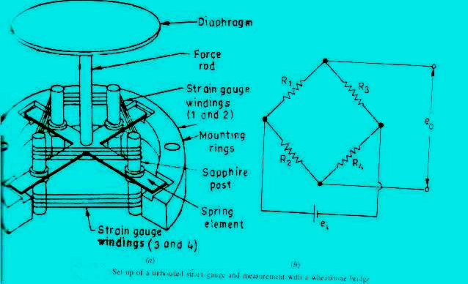
Cont..
Refer the figure below in which the diaphragm act as primary transducer. It convert pressure (the quantity to be measured) into displacement(the mechanical signal).
The displacement is then converted into change in resistance using strain gauge. Hence strain gauge acts as the secondary transducer.

Slide 44
Cont..
2. Active and Passive Transducers
Active transducers
Transducers, on the basis of methods of energy conversion used, may be classified into active and passive transducers. Self-generating type transducers i.e. the transducers, which develop their output the form of electrical voltage or current without any auxiliary source, are called the active transducers. Such transducers draw energy from the system under measurement. Normal such transducers give very small output and, therefore, use of amplifier becomes essential.

Slide 45
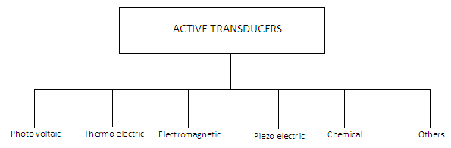
Cont..

Slide 46
Cont..
Example
Piezoelectric Transducer

Slide 47
Cont..
Passive transducer
Transducers, in which electrical parameters i.e. resistance, inductance or capacitance changes with the change in input signal, are called the passive transducers. These transducers require external power source for energy conversion. In such transducer electrical parameters i.e. resistance, inductance or capacitance causes a change in voltages, current or frequency of the external power source. These transducers may draw source energy from the system under measurement. Resistive, inductive and capacitive transducer falls in this category.

Slide 48
Cont..
A DC power supply or an audio frequency generator is used as an external power source.
These transducers produce the output signal in the form of variation in resistance, capacitance, inductance or some other electrical parameter in response to the quantity to be measured.

Slide 49
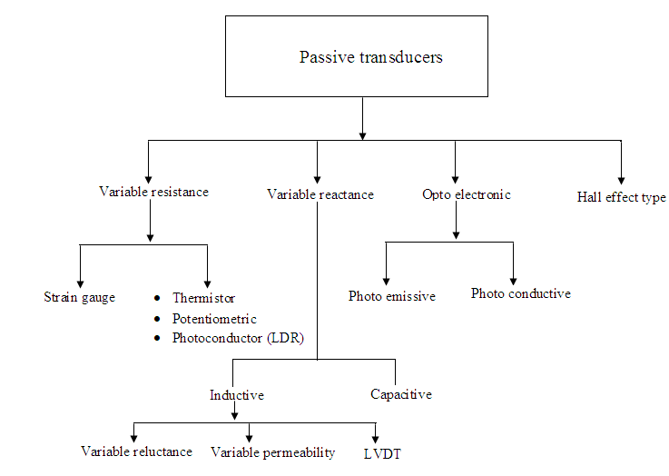
Cont..

Slide 50
Cont..
Resistive transducers :
Resistive transducers are those transducers in which the resistance change due to the change in some physical phenomenon.
The resistance of a metal conductor is expressed by a simple equation.
R = ρL/A
Where R = resistance of conductor in Ω
L = length of conductor in m
A = cross sectional area of conductor in m²
ρ = resistivity of conductor material in Ω-m.
There are 4 type of resistive transducers.
Potentiometers (POT)
Strain gauge
Thermistors
Resistance thermometer

Slide 51
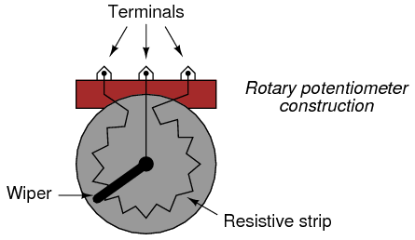
Cont..
Potentiometer
The potentiometer are used for voltage division. They consist of a resistive element provided with a sliding contact. The sliding contact is called as wiper.
The contact motion may be linear or rotational or combination of the two. The combinational potentiometer have their resistive element in helix form and are called helipots.
Fig shows a linear pot and a rotary pot.

Slide 52
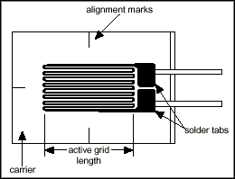
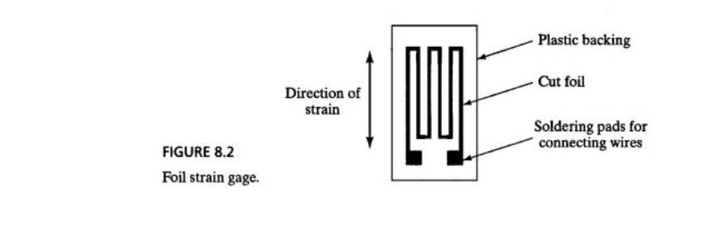
Cont..
Strain gauge
The strain gauge is a passive, resistive transducer which converts the mechanical elongation and compression into a resistance change.
This change in resistance takes place due to variation in length and cross sectional area of the gauge wire, when an external force acts on it.

Slide 53
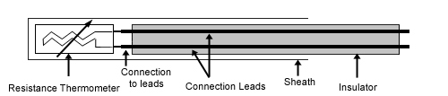
Cont..
Resistance thermometer
Resistance of metal increase with increases in temperature. Therefore metals are said to have a positive temperature coefficient of resistivity.
Fig shows the simplest type of open wire construction of platinum résistance thermometer. The platinum wire is wound in the form of spirals on an insulating material such as mica or ceramic.
This assembly is then placed at the tip of probe
This wire is in direct contact with the gas or liquid whose temperature is to be measured.

Slide 54
Cont..
The resistance of the platinum wire changes with the change in temperature of the gas or liquid
This type of sensor have a positive temperature coefficient of resistivity as they are made from metals they are also known as resistance temperature detector
Resistance thermometer are generally of probe type for immersion in medium whose temperature is to be measured or controlled.

Slide 55
Cont..
Thermistor
Thermistor is a contraction of a term “thermal resistor”.
Thermistor are temperature dependent resistors. They are made of semiconductor material which have negative temperature coefficient of resistivity i.e. their resistance decreases with increase of temperature.
Thermistor are widely used in application which involve measurement in the range of 0-60º Thermistor are composed of sintered mixture of metallic oxides such as magnese, nickle, cobalt, copper, iron and uranium

Slide 56
Cont..
The thermistor may be in the form of beads, rods and discs.
The thermistor provide a large change in resistance for small change in temperature. In some cases the resistance of thermistor at room temperature may decreases as much as 6% for each 1ºC rise in temperature

Slide 57
Cont..
3. Analog and Digital Transducers
Transducers, on the basis of nature of output signal, may be classified into analog and digital transducers. Analog transducer converts input signal into output signal, which is a continuous function of time such as thermistor, strain gauge, LVDT, thermo-couple etc. Digital transducer converts input signal into the output signal of the form of pulse e.g. it gives discrete output.
These transducers are becoming more and more popular now-a-days because of advantages associated with digital measuring instruments and also due to the effect that digital signals can be transmitted over a long distance without causing much distortion due to amplitude variation and phase shift. Sometimes an analog transducer combined with an ADC (analog-digital convector) is called a digital transducer

Slide 58
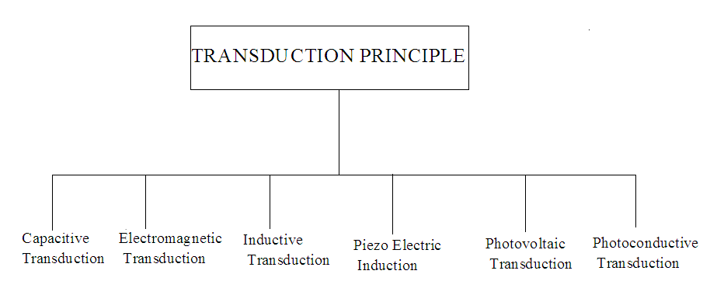
Cont..
4. On the basis of transduction principle
A process by which a transducer converts one type of energy to another

Slide 59
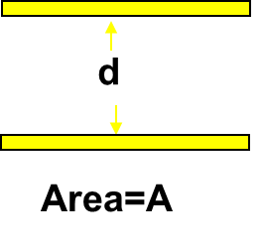
Cont..
Capacitive transducer:
In capacitive transduction transducers the measurand is converted to a change in the capacitance.
A typical capacitor is comprised of two parallel plates of conducting material separated by an electrical insulating material called a dielectric. The plates and the dielectric may be either flattened or rolled.
The purpose of the dielectric is to help the two parallel plates maintain their stored electrical charges.
The relationship between the capacitance and the size of capacitor plate, amount of plate separation, and the dielectric is given by;
d is the separation distance of plates (m)
C is the capacitance (F, Farad)
ε0 : absolute permittivity of vacuum
εr : relative permittivity
A is the effective (overlapping) area of capacitor plates (m2)

Slide 60
Cont..
Electromagnetic transduction:
In electromagnetic transduction, the measurand is converted to voltage induced in conductor by change in the magnetic flux, in absence of excitation.
The electromagnetic transducer are self generating active transducers
The motion between a piece of magnet and an electromagnet is responsible for the change in flux

Slide 61
Cont..
Inductive transducer:
In inductive transduction, the measurand is converted into a change in the self inductance of a single coil. It is achieved by displacing the core of the coil that is attached to a mechanical sensing element
Piezo electric induction :
In piezoelectric induction the measurand is converted into a change in electrostatic charge (q) or voltage (V) generated by crystals when mechanically it is stressed as shown in fig.

Slide 62
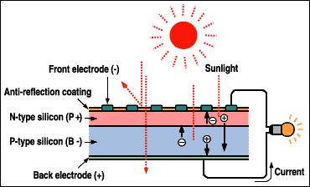
Cont..
Photovoltaic transduction :
In photovoltaic transduction the measurand is converted to voltage generated when the junction between dissimilar material is illuminated as shown in fig.

Slide 63
Cont..
Photo conductive transduction :
In photoconductive transduction the measurand is converted to change in resistance of semiconductor material by the change in light incident on the material

Slide 64
Cont..
5. Transducers and Inverse Transducers
Transducer, as already defined, is a device that converts a non-electrical quantity into an electrical quantity. Normally a transducer and associated circuit has a non-electrical input and an electrical output, for example a thermo-couple, photoconductive cell, pressure gauge, strain gauge etc. An inverse transducer is a device that converts an electrical quantity into a non-electrical quantity. It is a precision actuator having an electrical input and a low-power non-electrical output.
For examples a piezoelectric crystal and transnational and angular moving-coil elements can be employed as inverse transducers. Many data-indicating and recording devices are basically inverse transducers. An ammeter or voltmeter converts electric current into mechanical movement and the characteristics of such an instrument placed at the output of a measuring system are important. A most useful application of inverse transducers is in feedback measuring systems.

Slide 65
Selection Of Transducers
In a measurement system the transducer (or a combination of transducers) is the input element with the critical function of transforming some physical quantity to a proportional electrical signal. So selection of an appropriate transducer is most important for having accurate results.
The first step in the selection procedure is to clearly define the nature of quantity under measurement (measurand) and know the range of magnitudes and frequencies that the measurand is expected to exhibit. Next step will be to examine the available transducer principles for measurement of desired quantity. The type of transducer selected must be compatible with the type and range of the quantity to be measured and the output device.

Slide 66
Cont..
In case one or more transducer principles are capable of generating a satisfactory signal, decision is to be taken whether to employ a commercially available transducer or build a suitable transducer. If the transducers are available in the market at a suitable price, the choice will probably be to purchase one of them, otherwise own transducer will have to be designed, built and calibrated.
The points to be considered in determining a transducer suitable for a specific measurement are as follows:
Operating Range. The range of the transducer should be large enough to encompass all the expected magnitudes of the measurand.
Sensitivity. The transducer should give a sufficient output signal per unit of measured input in order to yield meaningful data.

Slide 67
Cont..
Electrical Output Characteristics. The electrical characteristics-the output im­pedance, the frequency response, and the response time of the transducer output signal should be compatible with the recording device and the rest of the measuring system equipment
Physical Environment. The transducer selected should be able to withstand the environmental conditions to which it is likely to be subjected while carrying out measurements and tests.
Such parameters are temperature, acceleration, shock and vibration, moisture, and corrosive chemicals might damage some transducers but not others.
The errors inherent in the operation of the transducer itself, or those errors caused by environmental conditions of the measurement, should be small enough or controllable enough that they allow meaningful data to be taken.

Slide 68
Cont..
Errors.
However the total measurement error in a transducer-activated system may be reduced to fall within the required accuracy range by adopting the following techniques.
Calibrating the transducer output against some known standards while in use under actual test conditions. This calibration should be performed regularly as the measurement proceeds.
Continuous monitoring of variations in the environmental conditions of the transducer and correcting the data accordingly.
Controlling the measurement environment artificially in order to reduce possible transducer errors. Artificial environmental control includes the enclosing of the transducer in a temperature-controlled housing and isolating the device from external shocks and vibrations.

Slide 69
Possible questions
What does operating range, sensitivity, linearity, repeatability mean in as far as transducers are concerned?
Briefly explain the five (5) basic requirements of a transducer for its effective/proper operation
What distinguishes a transducer from a sensor?

Slide 70
The end

Slide 71

Sensors
Is a device that detects/measures a signal or stimulus. It acquires information from the real world
A sensor acquires a physical parameter and converts it into a signal suitable for processing (e.g. optical, electrical, mechanical)
A sensor is a transducer that converts a physical stimulus from one form into a more useful form to measure the stimulus

Slide 72
Cont..
Sensors are omnipresent (universal). They embedded in our bodies, automobiles, airplanes, cellular telephones, radios, chemical plants, industrial plants and countless other applications.
No sensors no life

Slide 73
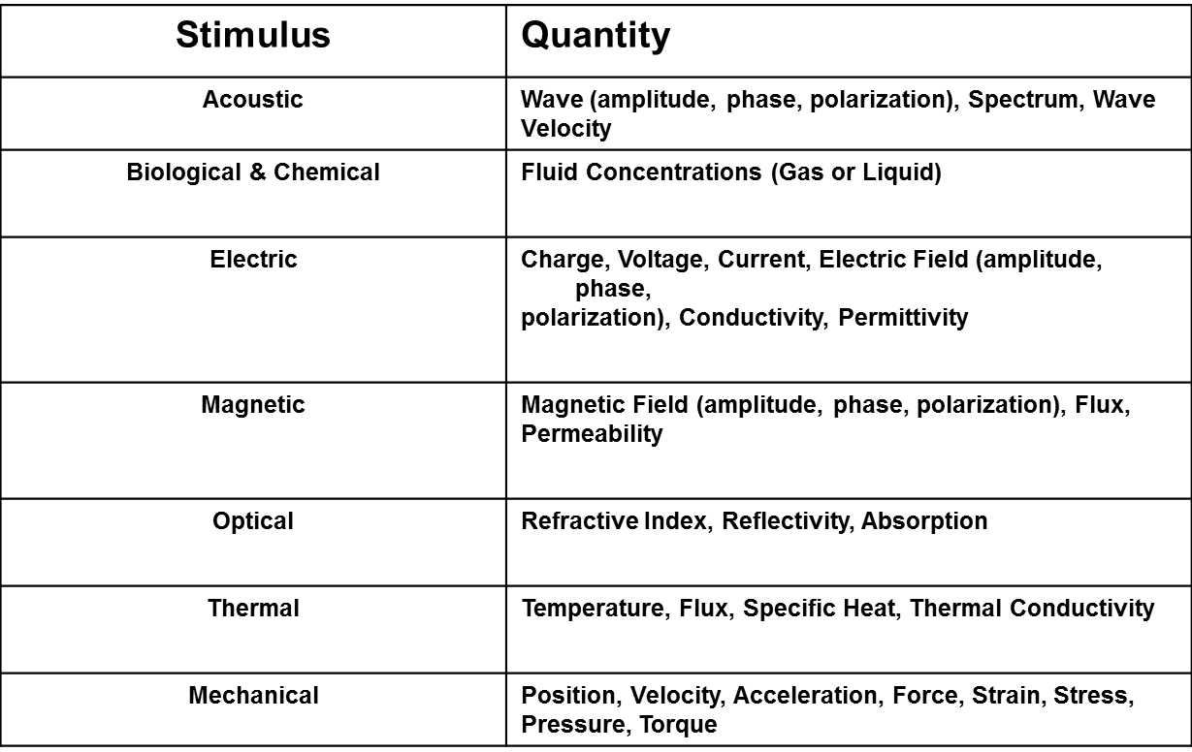
Cont..
Detectable Phenomenon

Slide 74
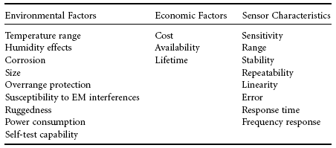
Choosing a Sensor

Slide 75
Basic requirements of a sensor
The same as of transducers (see slide number 35)

Slide 76
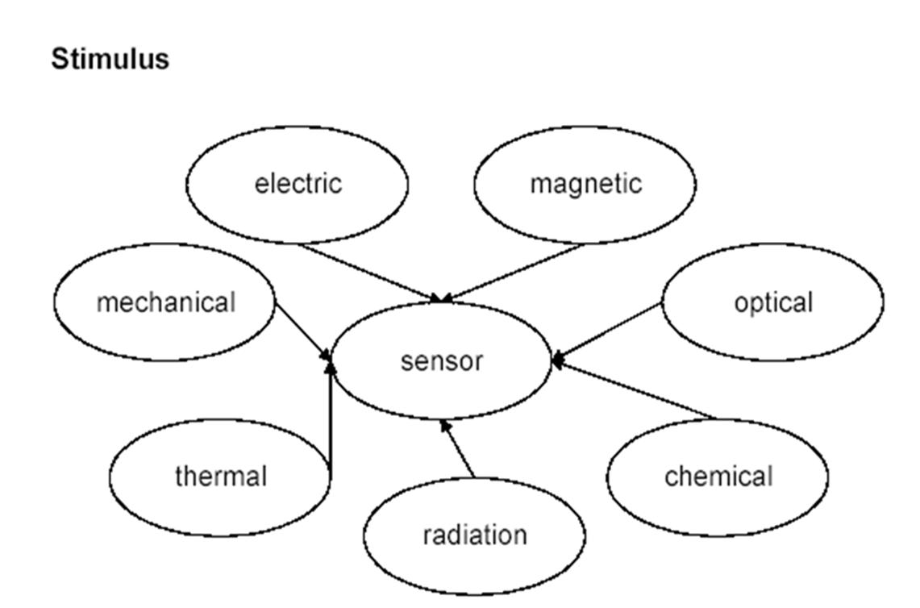
Classification of sensors
Attributes which can be used to classify sensors:
kind of stimulus
the working principle
the properties (attributes of the characteristic)
area of application
the nature of output

Slide 77
Cont..
Due to some of the mentioned attributes, we can classify sensors also as:
Analogue or digital (discrete)
Active and passive
See clarification from transducers’ topic

Slide 78
Cont..
Mechanical sensors
(Vibration and shock sensors)
For mechanical sensors, there must be a motion as a stimulus to be sensed
Whenever a structure moves, it experiences acceleration (twist, vibration, and shock ). Measuring this acceleration promotes an understanding of the dynamic characteristics that govern the object's behavior. The data can be used to modify response, enhance ruggedness, improve durability, and/or reduce noise and vibration.
e.g Accelerometers are sensing transducers that provide an output proportional to acceleration, vibration, and shock. The piezoelectric accelerometer is the most popular class of these devices; other types are based on piezo-resistive, capacitive, and servo technologies

Slide 79
Cont..
Other type of sensors which can fall under this category are:
Pressure sensor – measures pressure
Barometer – measures atmospheric pressure
Altimeter – measures the altitude of an object above a fixed level
Liquid flow sensor – measures liquid flow rate
Gas flow sensor – measures velocity, direction, and/or flow rate of a gas

Slide 80
Cont..
Thermal Sensors
Thermometer – measures absolute temperature
Thermocouple gauge– measures temperature by its effect on two dissimilar metals
Calorimeter – measures the heat of chemical reactions or physical changes and heat capacity
Electrical Sensors
Ohmmeter – measures resistance
Voltmeter – measures voltage
Galvanometer (specific type of ammeter) – measures current
Watt-hour meter – measures the amount of electrical energy supplied to, and used by a residence or business

Slide 81
Cont..
Chemical Sensors
Chemical sensors detect the presence of certain chemicals or classes of chemicals and quantify, the amount and/or type of chemical to be detected.
Oxygen sensor – measures the percentage of oxygen in a gas or liquid being analyzed
Carbon dioxide detector – detects the presence of CO2, etc
Optical
Light sensors (photo-detectors) – detects light and electromagnetic energy
Photocells (photo-resistor) – a variable resistor affected by intensity changes in ambient light.
Infra-red sensor – detects infra-red radiation

Slide 82
Cont..
Acoustic
Seismometers – measures seismic waves
Acoustic wave sensors – measures the wave velocity in the air or an environment to detect the chemical species present
Other
Motion – detects motion
Speedometer – measures speed
Geiger counter – detects atomic radiation
Biological – monitors human cells

